Slide 1


CITS1003 Introduction to Cybersecurity Exam Example Questions

Slide 2
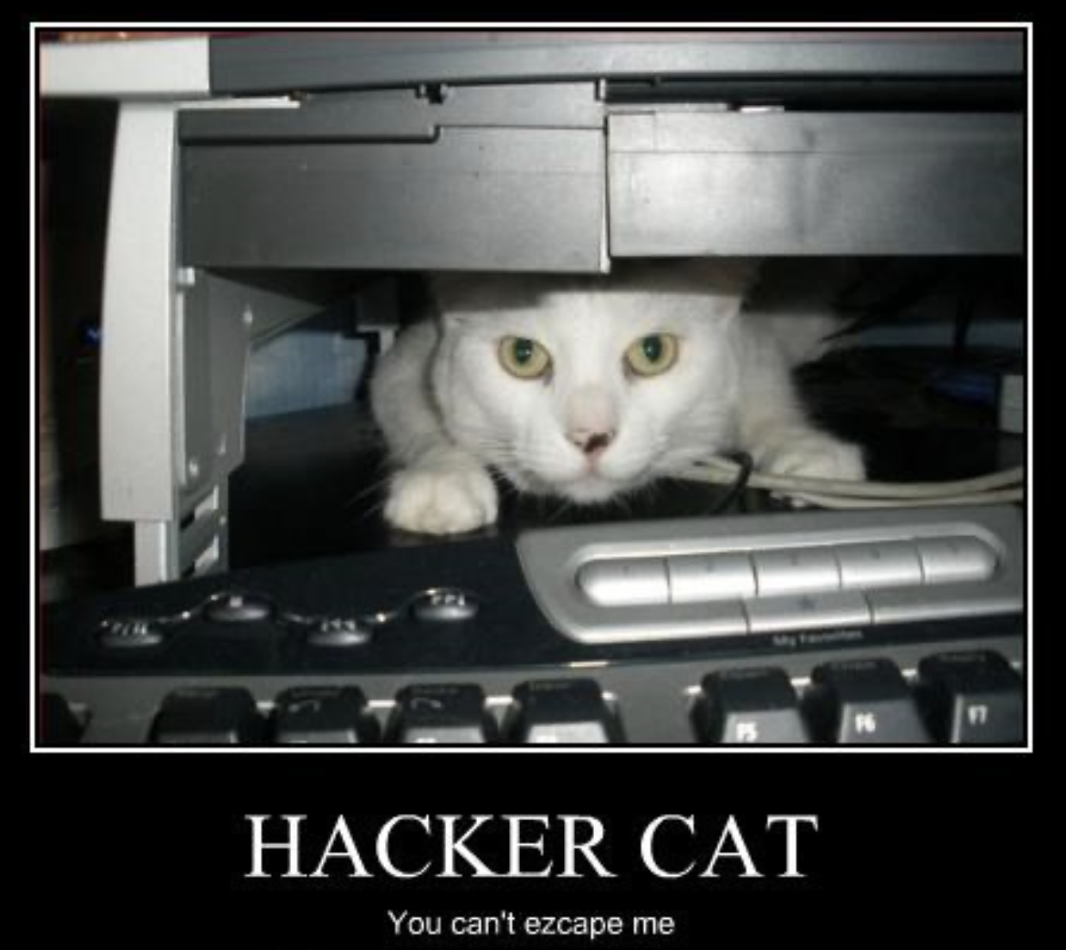
A unit about cats cybersecurity

Slide 3

3 Things
Understand the format of a question
01
Understand how to go about analysing the question
02
Understand how to answer the question
03

Slide 4
Exam Format
5 questions with 2-3 parts to each
Exam total points: 100
Exam lasts 2 hours
Worth 50% of unit marks
Open book

Slide 5
Example Questions
A video game company has noticed some unusually high CPU usage on one of their multiplayer game servers. One of the developers looked at the process list and found a suspicious program that seemed to be running a cryptocurrency miner and sending the mined currency to an unknown wallet. The company suspects that the attack may have come from a player exploiting an unknown vulnerability in the game or maybe through a successful phishing campaign targeted at a developer with access to the server.
You oversee the incident response team that has been called in to deal with the situation outlined in Scenario 1.

Slide 6
Example Questions
Describe the 4 stages you would go through in handling the incident. Include at least 2 activities in each stage specific to the scenario above
Describe 3 actions that the incident response could undertake as part of the “Eradication, Containment and Recovery” phase of the incident response
How was the company’s systems and data impacted in terms of Confidentiality, Integrity, Availability, Authorization, Accountability and Non-Repudiation?
What is an Indicator of Compromise (IoC)? Are there any IoCs that could be found in the above scenario?
What motivation could the primary threat actor in the above scenario have?

Slide 7
Example Questions
A company is undertaking a risk management assessment of their office network infrastructure, including routers, switches and file servers. You have been tasked identifying potential vulnerabilities and putting controls in place to reduce or mitigate risk. A security consultant has outlined five potential threat actors as:
Cyber criminals
Hardware failure
Social engineers
Former employees
Bushfires

Slide 8
Example Questions
For each of the above threat actors, choose one possible threat and briefly discuss the level of risk
For each of the above threat actors, list at least one vulnerability that they could exploit
For each of the risks list two controls that could help reduce or mitigate the risk and state their control type and control function
List two Technical controls and discuss how they could help reduce or mitigate the above risks

Slide 9
Example Questions
A member of the Cyber Cat Criminals (CCC) hacker group has accidentally leaked the location of their hideout in the EXIF data of an image posted to social media. The authorities have raided the hideout and found a desktop computer that appears to be logged in and is currently running some kind of cybersecurity attack. A digital forensics team has been called in to investigate.

Slide 10
Example Questions
Describe two major issues that digital forensics experts need to be concerned about during the data collection phase in the above scenario
What information could be found in a memory dump of the computer that might not be recoverable from the hard drive and how could it be useful to the investigation
What information could be found in a wireshark network capture?
What information could be found on a hard drive?
What other information might be contained in the image?
What tools could be used during the forensic investigation

Slide 11
Example Questions
A web application for hosting user created restaurant reviews is being audited for potential security vulnerabilities. The Webapp uses mostly custom code with some standard frameworks and provides user accounts with password login for reviewers. You have been tasked to perform a penetration test and have been given no access to the site other than what is available to the public.

Slide 12
Example Questions
Is this a white box test or a black box test?
Describe a common web exploit that might affect the above scenario.
What would you need to do before starting the test?
What tools might you use to complete the test?

Slide 13
Example Question
A Swedish hacker, Lisbeth Salander, has found a zero day in Windows 11. She wants to communicate it to Satya Nadella (CEO of Microsoft) directly via PGP (a public key encryption program). Nadella has never met Salander and has never used open source software before and has downloaded PGP.
Both Salander and Nadella know journalist Stephen Levy. Salander has the correct keys for Levy.

Slide 14
Example Question (continued…)
Using your knowledge of public key encryption, describe a sequence of messages to get Salander the key she needs to communicate with Nadella. When answering, consider:
[1] What key did Salander need to communicate with Nadella? [2] How could Salander trust that she had the correct key from Nadella?
In all these communications, Salander wanted all communications to be encrypted and to be sure that people could trust the sender's identity.
[3] Describe how Salander, Levy and Nadella could know with certainty that the sender of an email was the person they claimed to be?

